Slide 1
Michael's Sprint Goals
Design a basic main menu UI
Create a basic submenu navigation system
Ensure that future features are accounted for in the main menu UI design.
Hours Expected
5 hours were on board. I expected it would take a couple more...

Slide 2
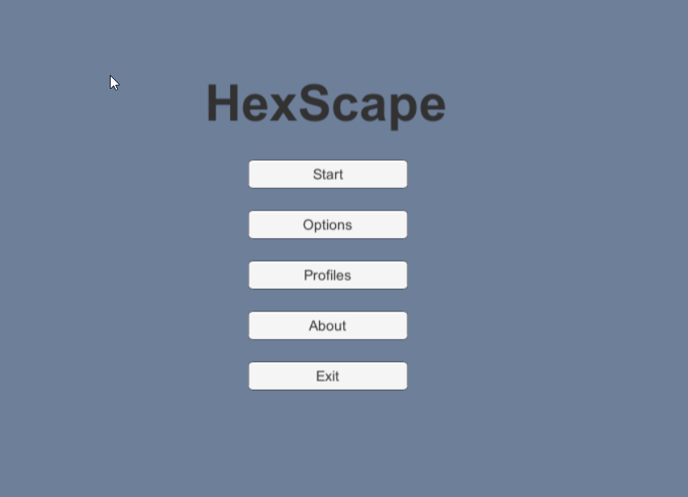
Menu Screenshot

Slide 3
Michael's Results
Created a main menu along with sub menus.
One parent main menu.
Three children sub menus – Options, Profile Select, About.
Created a couple basic scripts that hide all other menus not in use and show only the currently selected menu.
Actual time spent: 7 hours

